Slide 1
Research Accomplishments/Experience
Shamir Harry

Slide 2
Main Research Project

Slide 3
Broad Background Info
Rapid development of new genomic data coming from a variety of collaborative sources
Integrate and make relevant to current lab
Finding genes that potentially affect fruit shape and corresponding underlying SVs in tomato via bioinformatic pipeline
Why SVs?
Avoid randomly mutating candidate genes
Provide evolutionary backstory

Slide 4
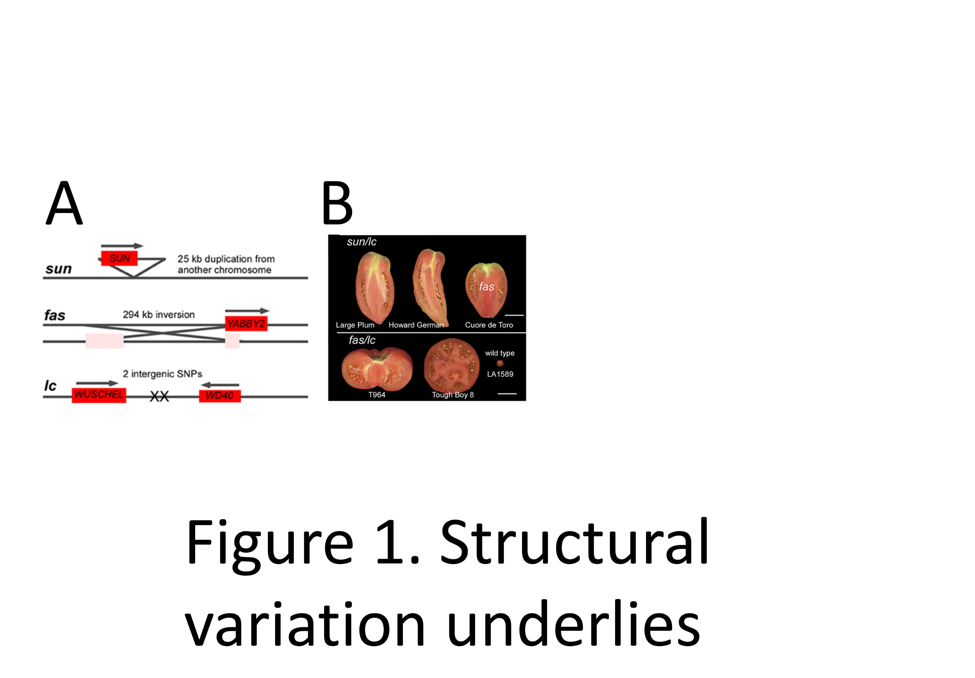
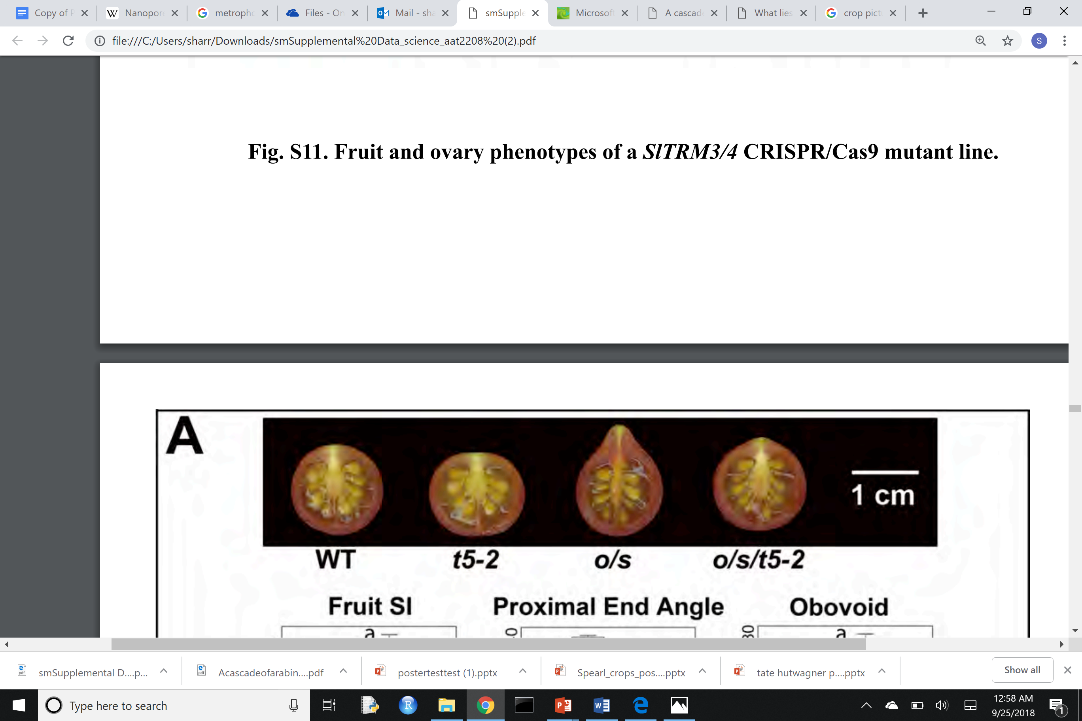
fas
SICLV3
RE
294 kb inversion splitting regulatory element
SIClV3
sun
Chr 10
SUN
25 kb interchromosomal duplication
Chr 7
SUN
sov1
SlOFP20
sov1/ovate
RE
31 kb deletion in regulatory element
SlOFP20
LA1589 (Zoom in)

Slide 5
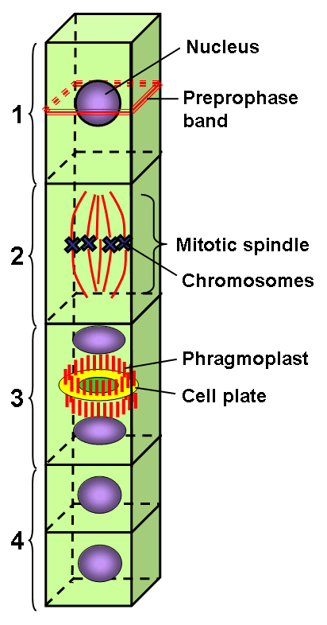
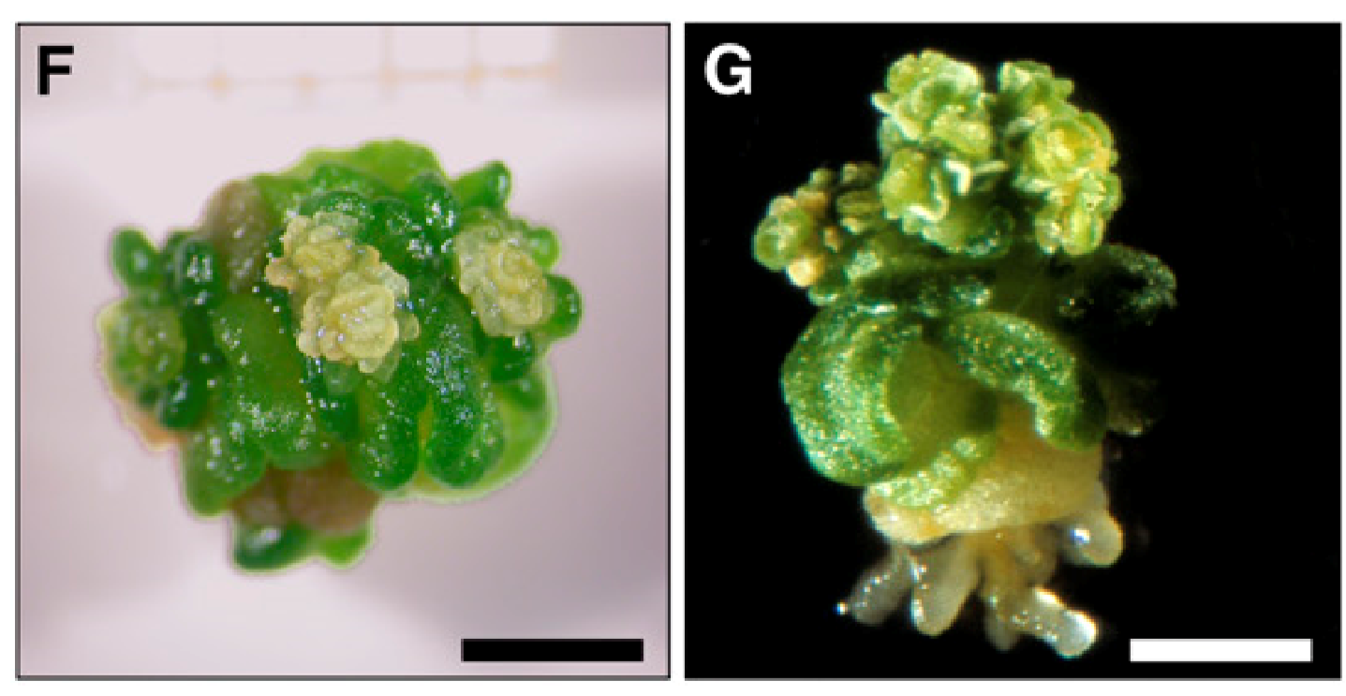
Defining Biological Question/ Basic Background
Need to narrow approach and avoid “shotgun”-like method
Preprophase band of dense microtubule array
PPB disruption has a major effect on spindle positioning
TON1 when mutated causes a complete loss of PPB (one of very few genes)
Mediate PPB via TTP complex
TRM proteins interact and relocalize (some shown to be needed
for TTP complex formation)
Arabidopsis study
Notes:
Plants do not have centrosomes to or some sort of physical microtuble organizing center to define cell division plane

Slide 6
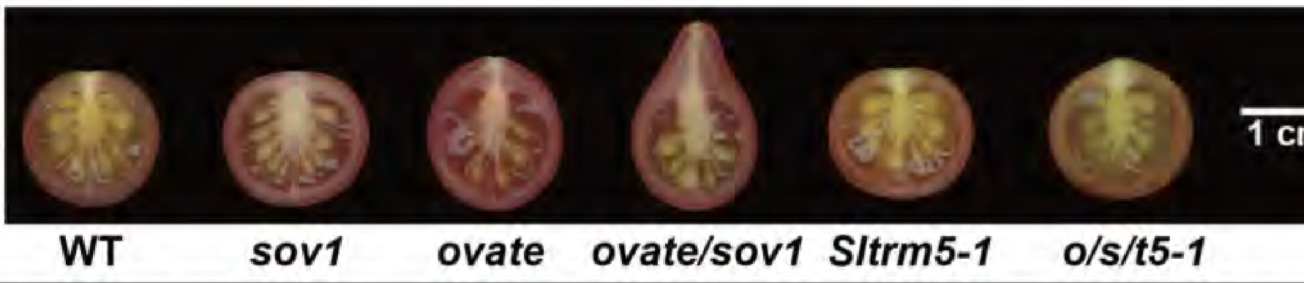
OVATE, important tomato fruit shape regulator, is modified by TRM5
Many TRMS interact with OVATE

Slide 7
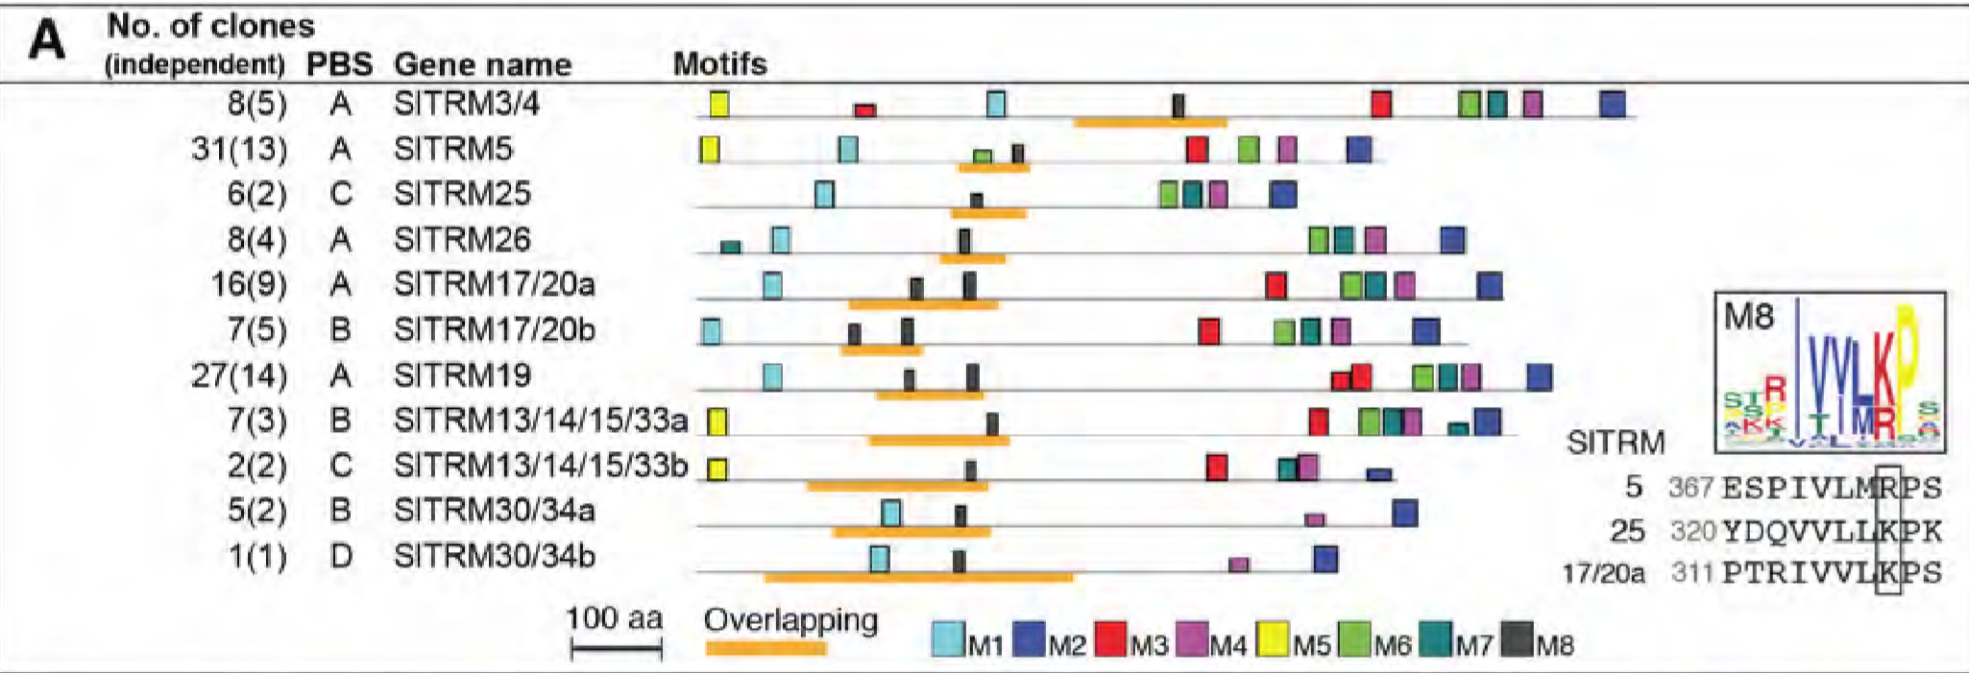

Slide 8
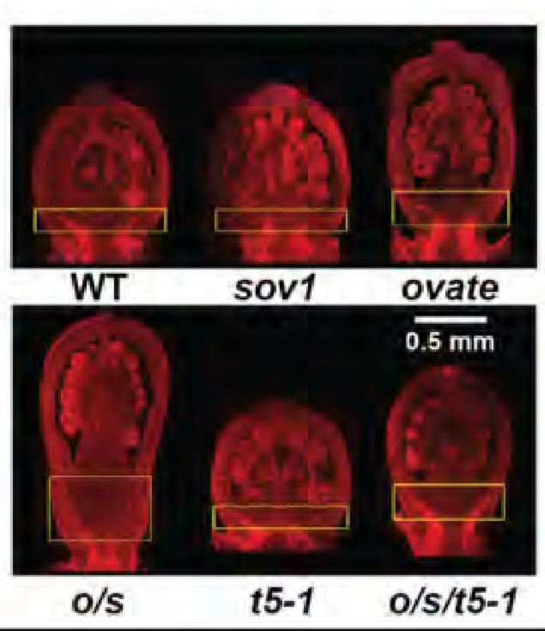
Phenotype can be observed early in development

Slide 9
Hypothesis/ Study Basis
Assumption: TRMs are link between OVATE and the TTP complex and describe how OVATE may be affecting cell division in early ovary development
No significant results looking at just OVATE
We seek genes correlated to these TRMs because TRMs have more domains indicating other interacting proteins that may be involved in desired pathway
Affect assembly/recruitment of TTP complex
Notes:
Assumption: TRMs are link between OVATE (and OFP20) and the TTP complex and describe how OVATE may be affecting cell division in early ovary development
Hypothesis: TRMs that (likely) interact with OVATE (have M8 and coexpress or physically interact by Y2H) and the genes that coexpress with these TRMs (potentially interact with the TRMs) may have a role in the process—affecting assembly or recruitment of TTP complex and ultimately affecting fruit shape
We seek genes correlated to these TRMs because TRMs have more domains indicating other interacting proteins that may be involved in desired pathway

Slide 10
Inputs
GOI list
Expression Data
SV list
Annotated Genome
Online Expression Database (more general expression data)

Slide 11
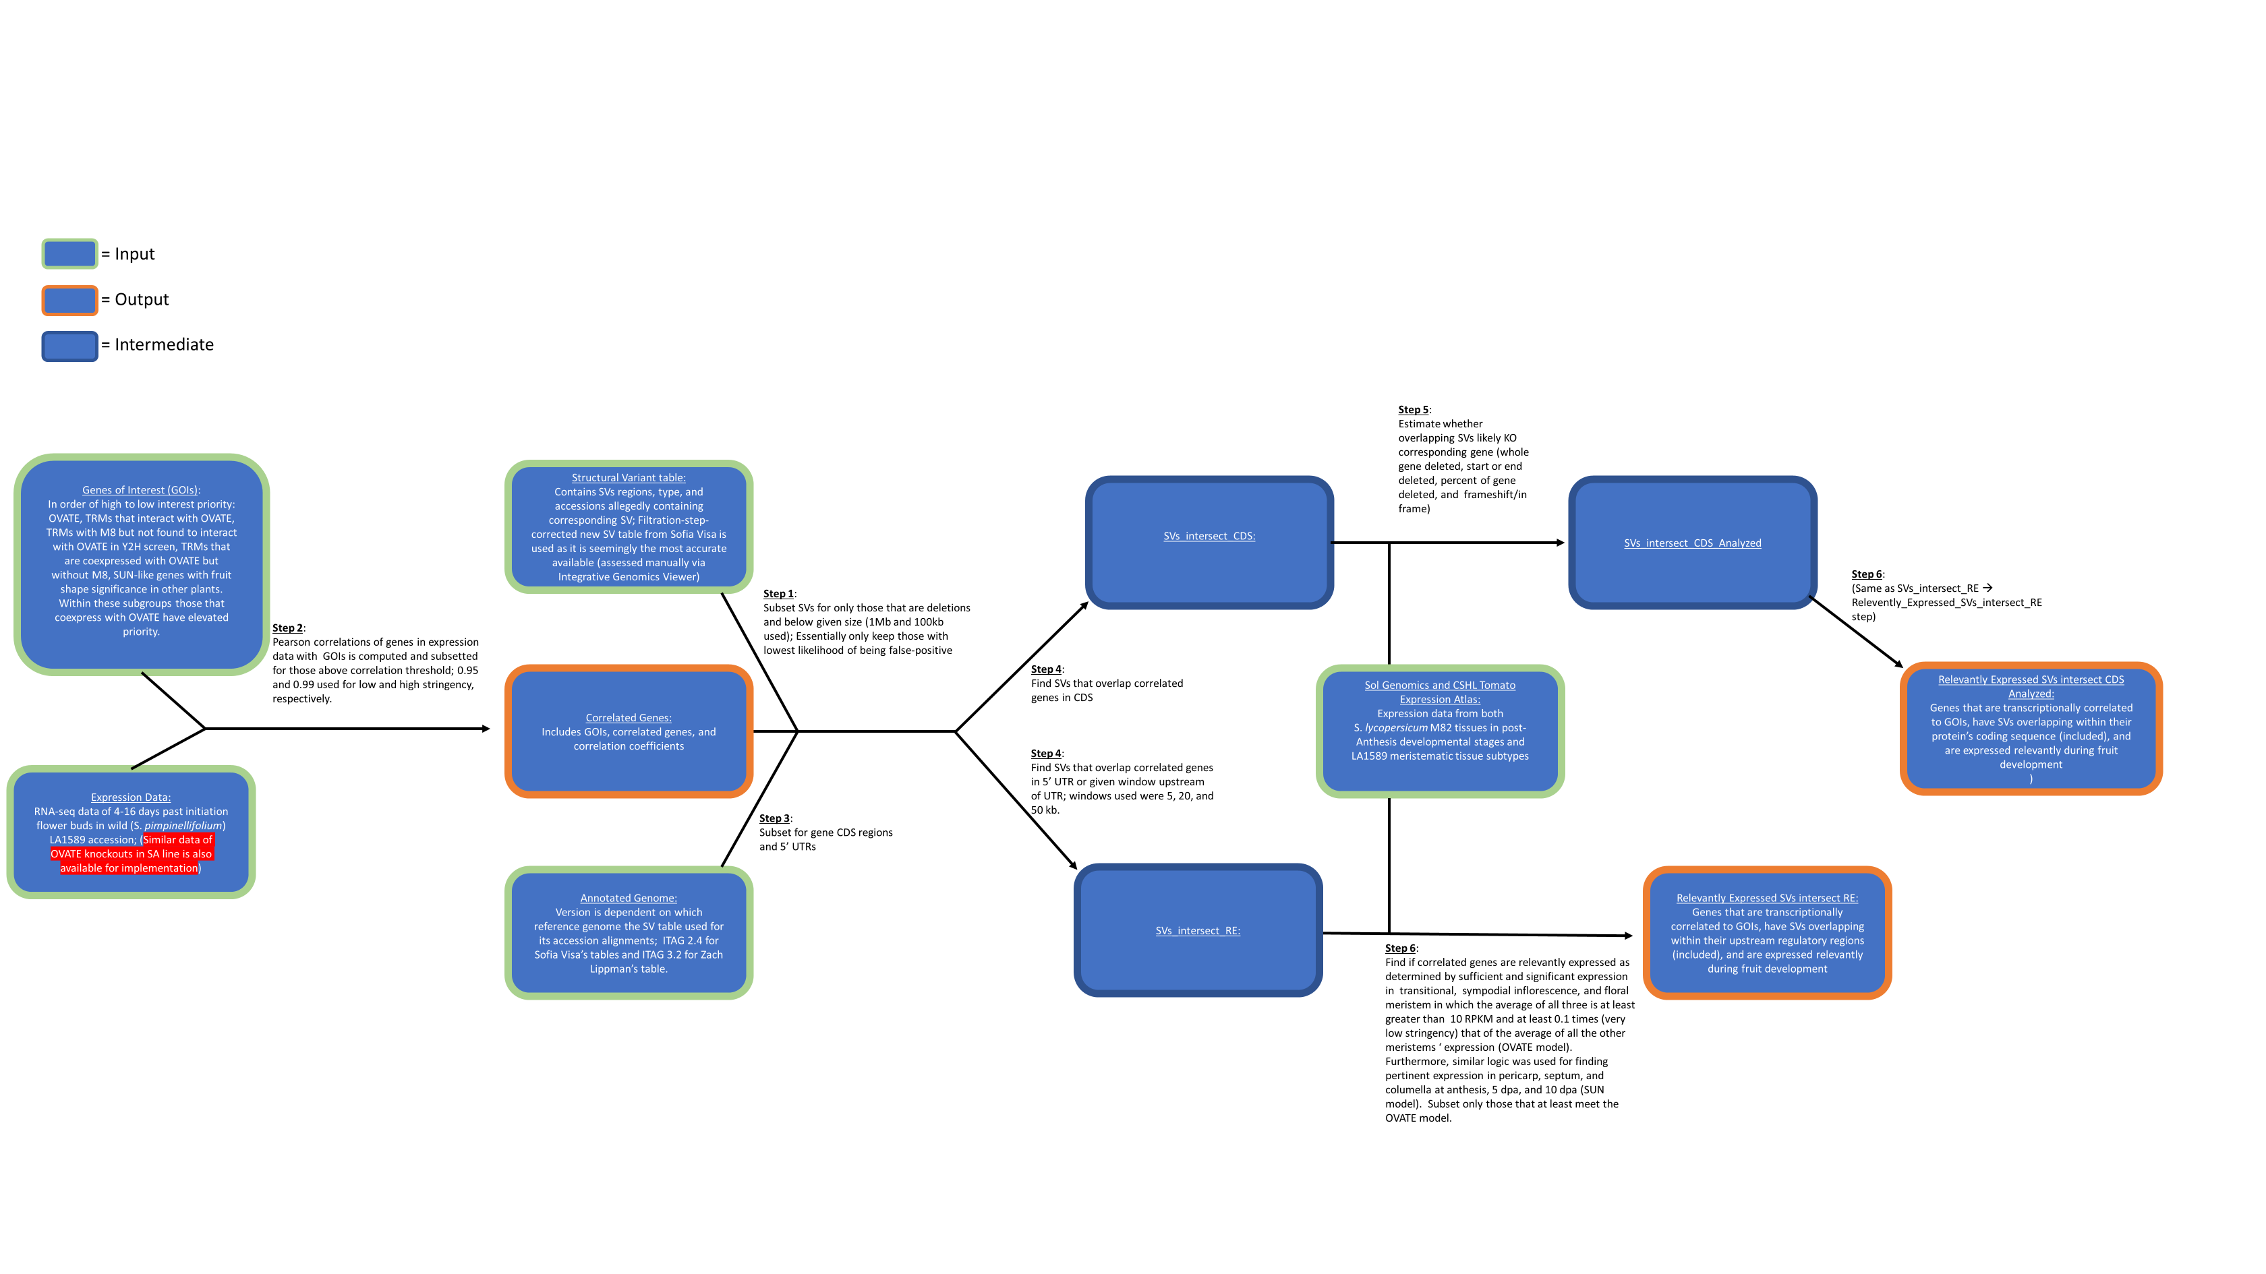
Pipeline Overview
*Accepts multiple parameters/thresholds for filtering and generates permutation of combinations*

Slide 12
More General Process
GOI list
Expression data
SV table
Annotated genome
Full CDS sets
Overlapping SVs and CDS
SVs upstream of genes
SVs only intersect fives
Correlated genes
Processed/subsetted SV table
Processed annotated genome
R1
R2
Linux/
bedtools
SV intersect CDS
SV intersect RE
SV intersect CDS gene list
SV intersect RE gene list
R3
SV intersect CDS + Relevant Expression
SV intersect RE + Relevant Expression
Solgenomics Expression Online Database
Custom expression data

Slide 13
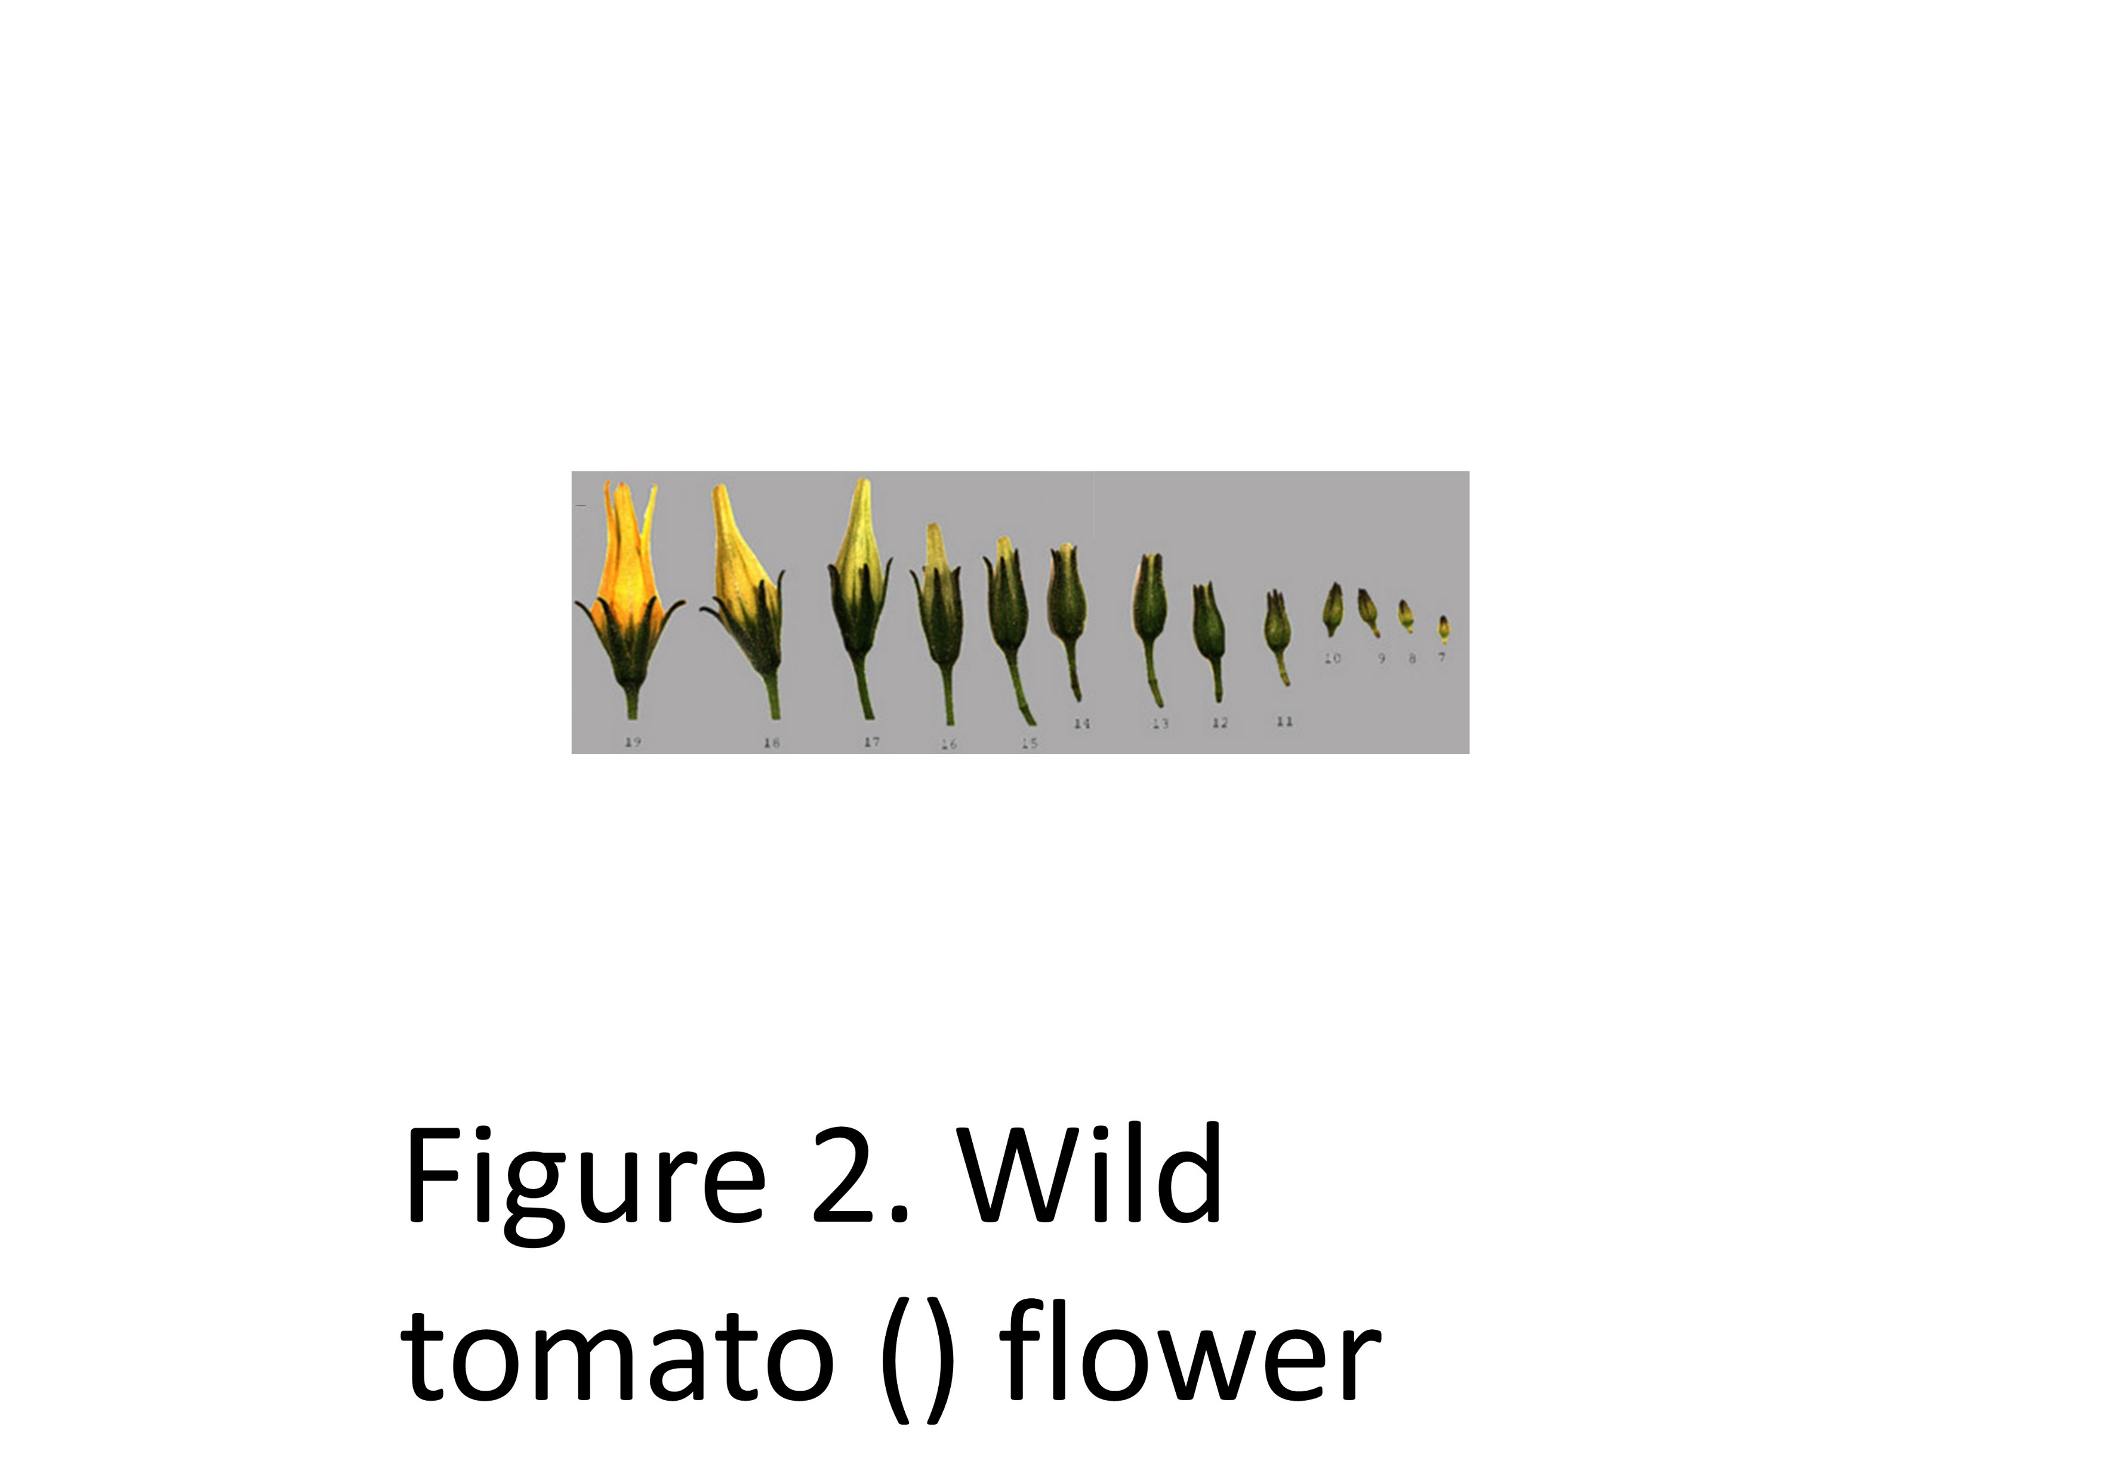
Pipeline Steps/Filtration
Step 1: Subset SVs
Remove SVs likely to be false positives (depends on table and sensitivity)
Smaller than certain size and of only a few SV types
Step 2: Find genes correlating to GOIs via Expression Table
RNA-seq data from most important time/space point (normalized) in appropriate accession (WT at known fruit shape altering loci)
If multiple take overlaps
Subset only those above Pearson Corr threshold
4-16 dpi in floral buds of commonly used Wild tomato accession

Slide 14
Step 3: Subset Annotated genome for CDS and 5’UTR
Focus on regions
Step 4: Find SVs overlapping CDS / Find SVs overlapping 5’UTR or 5’ upstream region
Affect protein directly / Affect protein expression
Specified range for 5’ Upstream region

Slide 15
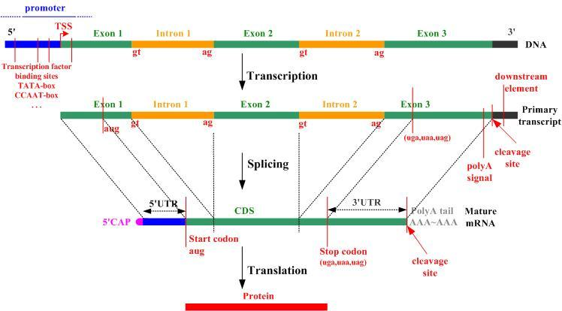

Slide 16
Step 5: Determine likely effect of SV on gene if overlap CDS
Step 6: See if genes are expressed in manner conducive toward effecting fruit shape
More general data
See if specific in early floral development via thresholds for expression level and ratios
Algorithm easily adjustable for desired filtration

Slide 17
How to interpret results?
Go from high stringency → low stringency based on findings (cycles of runs)
Based on gene ontology
Prioritize those that are:
manually curated
relating to cell division/growth
High frequency domains/families
Solyc07g063130 | Cell division protein kinase 10 (D3TRH8_GLOMM)
Solyc05g056040 | Auxin Response Factor 24 (manually curated)
Solyc05g014370 | Mitotic spindle checkpoint protein MAD2 (B6UEH3_MAIZE)
Solyc02g089200 | TM29 (manually curated)
Solyc01g094760 | Origin recognition complex 5 subunit (Q6EWX0_ARATH)
Solyc04g045560 | Squamosa promoter-binding protein 3 (manually curated)
Solyc10g009210 | Calmodulin-binding protein (Fragment) (Q9M451_CICAR)
Solyc08g082530 | Cell division protease ftsH homolog (FTSH_PORPU)
Solyc06g071140 | EARLY FLOWERING 5 (Q6QTF1_ARATH)
Solyc05g017980 | microtubule associated protein Type 1 (Q9C9X0_ARATH)
Solyc03g114850 | Squamosa promoter binding protein 6a (manually curated)
Notes:
Wanted to use monte carlo method to randomly vary the parameters and in order to find where (which set of parameters) we get most optimized results or closest to a specified desired value
The Monte Carlo strategy of randomly varying the model to improve fit to observed data was used. This involves finding lower X^2 values through each sweep but allowing space for it to go up so it does not get stuck at a local minimum. Equilibration was previously performed by the instructor which moved toward a set of parameters where X^2 against the fitted data was stabilized.

Slide 18
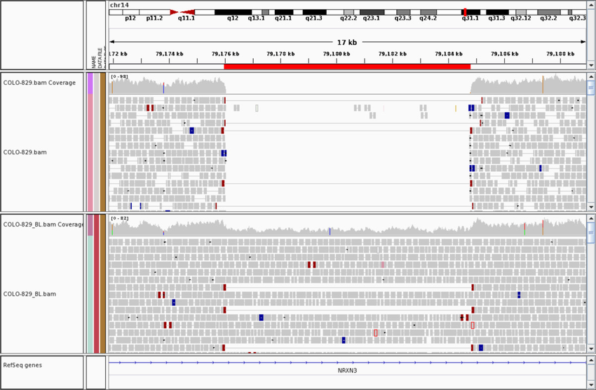
Manual verification
Check IGV with correct accessions to verify SVs presence
PCR in these accessions

Slide 19
Current/Future
SNP data
Statistical significance of outputted genes
Look at correlation overlaps/distribution and assess quality of tentative network
Automate some manual aspects of process
Development of transgenic lines

Slide 20
What I learned?
How to approach large-scale biological data
Use bioinformatics to address a relevant biological question
Fundamentals of coding
Familiarity with common biological data formats

Slide 21
Awards/Recognition
UGA 2018 Plant Center Undergraduate Research Award
Presented at Integrated Plant Science retreat
Presentation at UGA CURO symposium for undergraduate research (April)
Likely a mention in PhD student’s dissertation's discussion
If high quality genes found, lab will pursue them further in establishing the general pathways/network relating to fruit shape
Notes:
Phylogeny stuff in pepper and tomato and this information is relevant to that

Slide 22
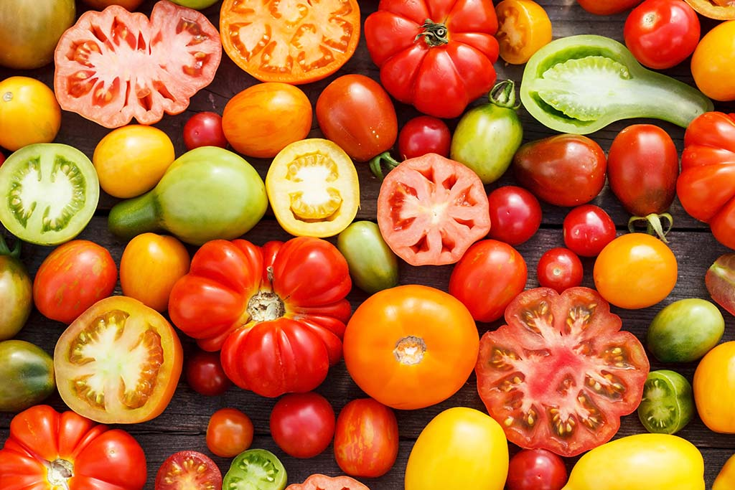



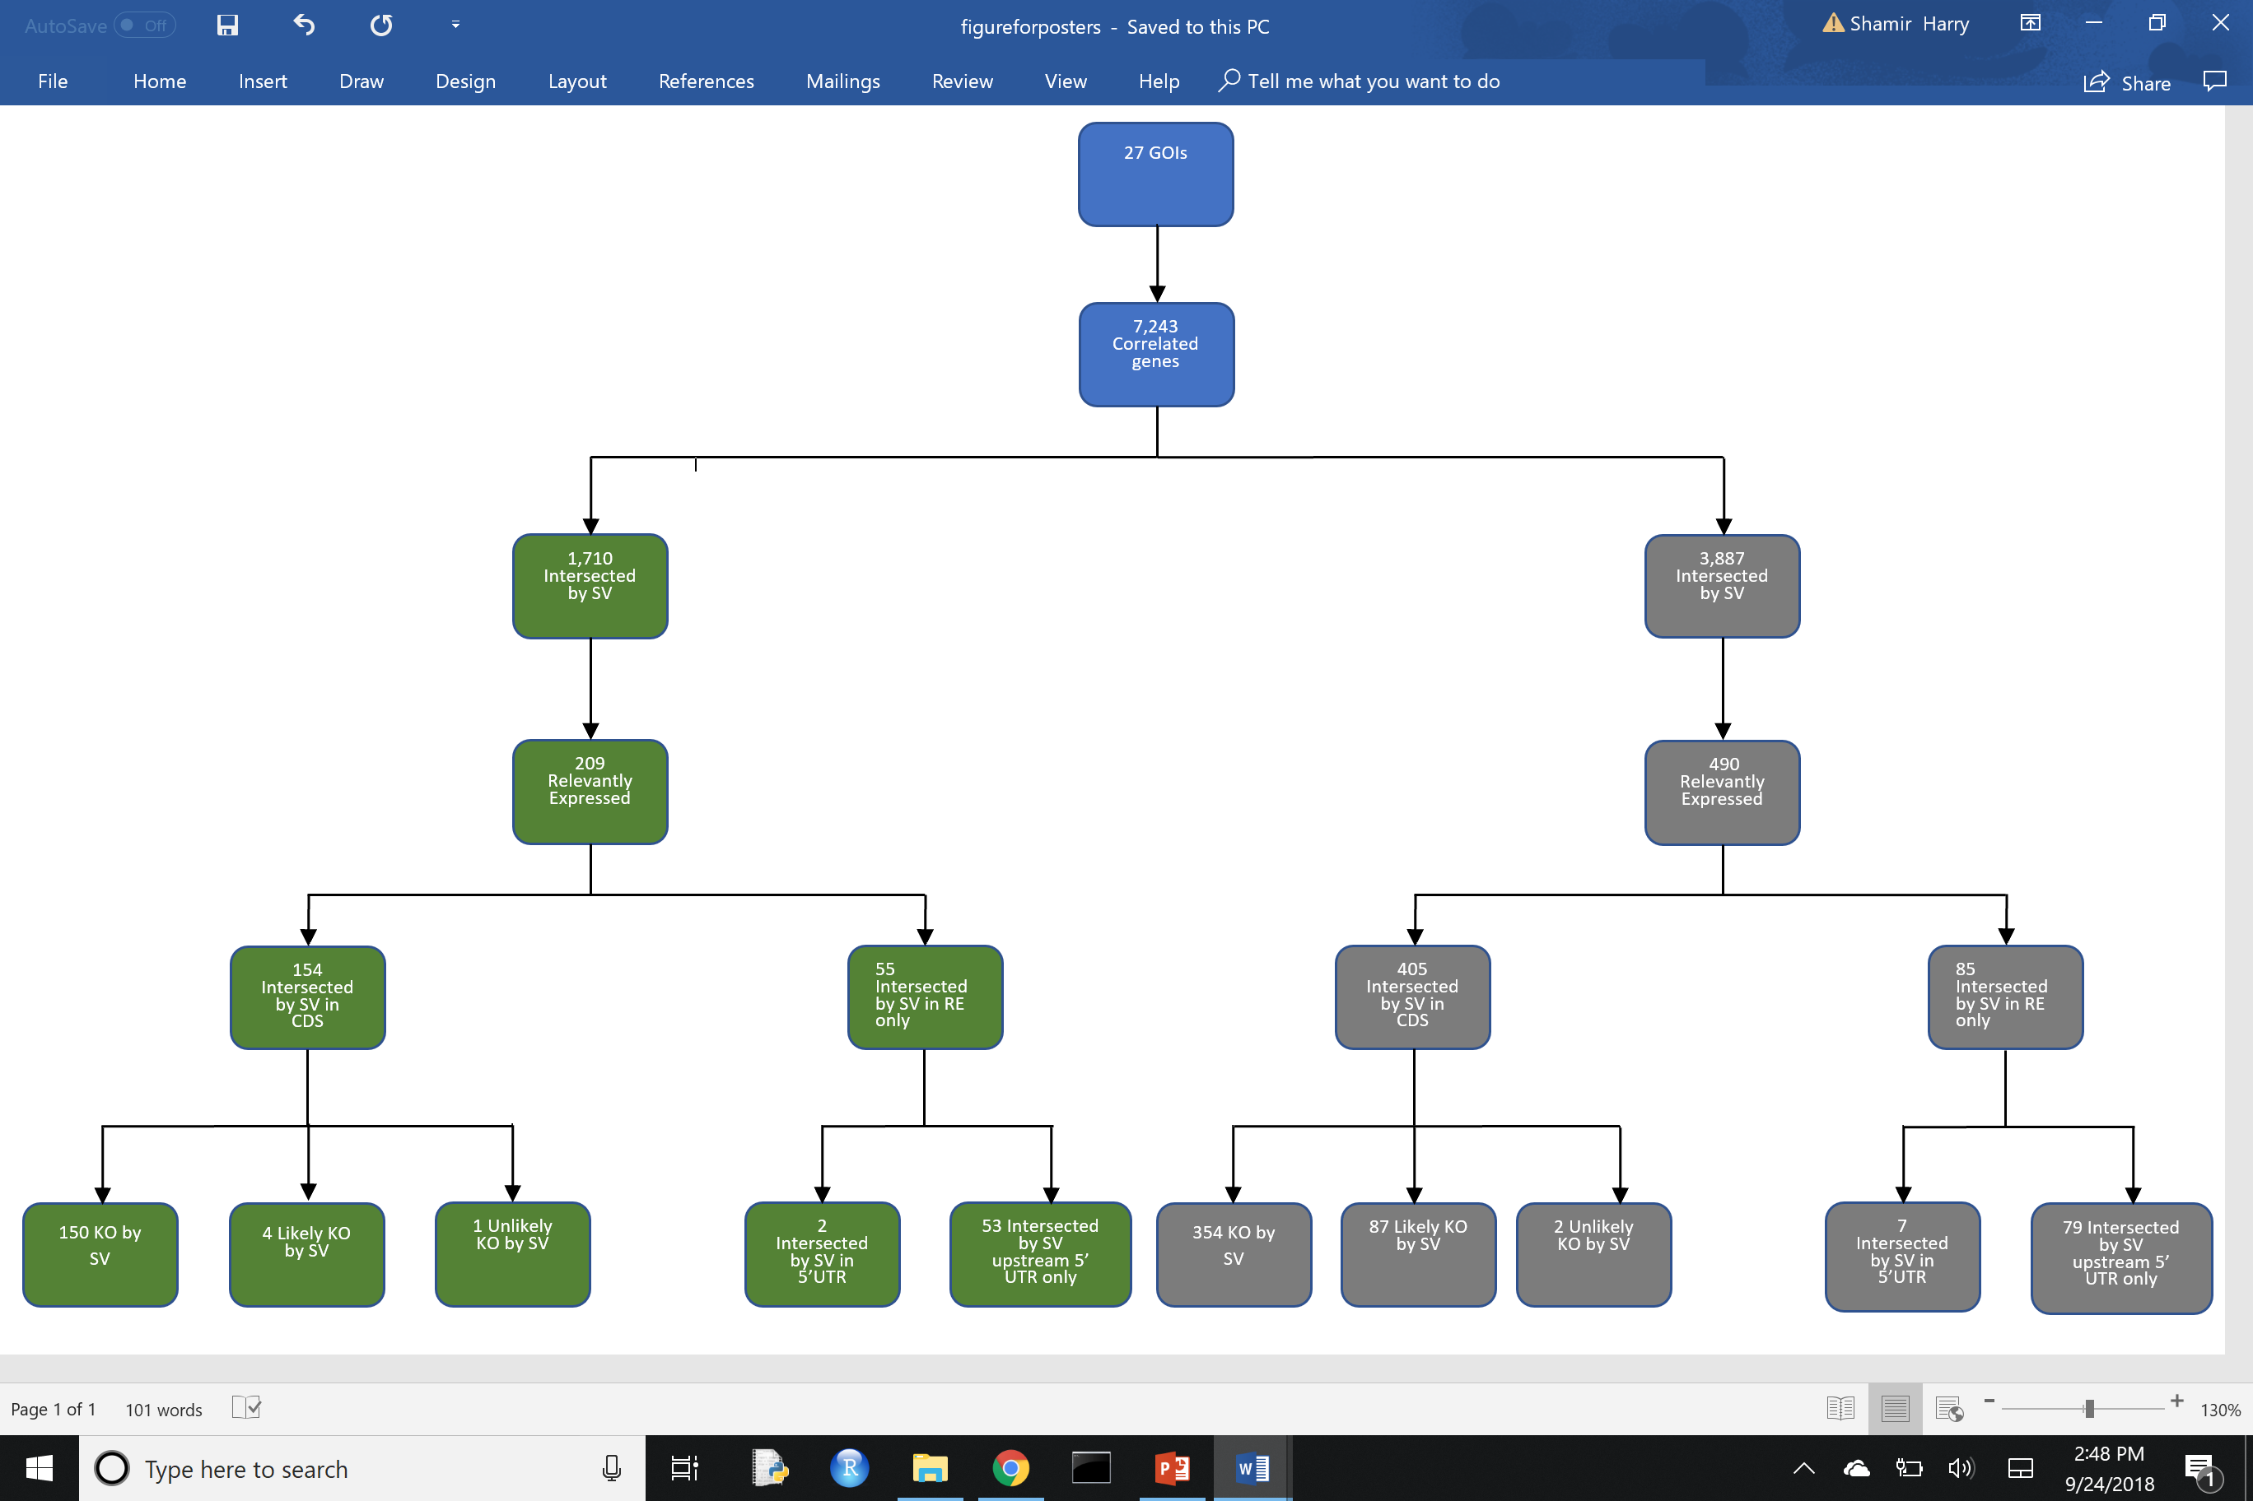
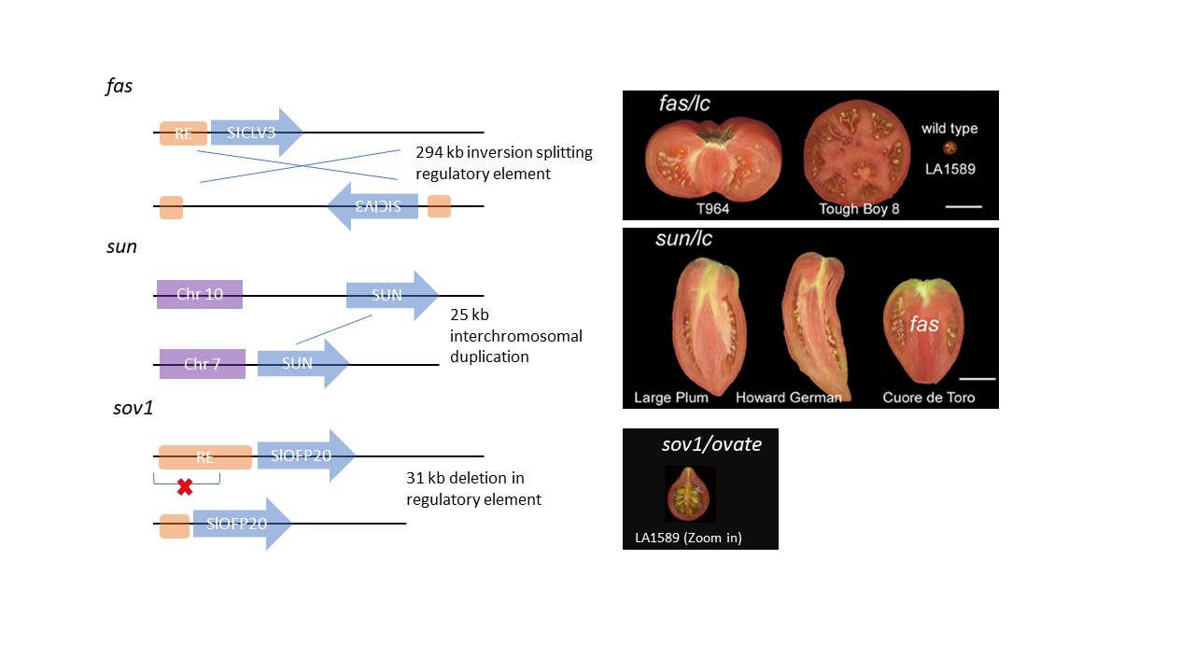
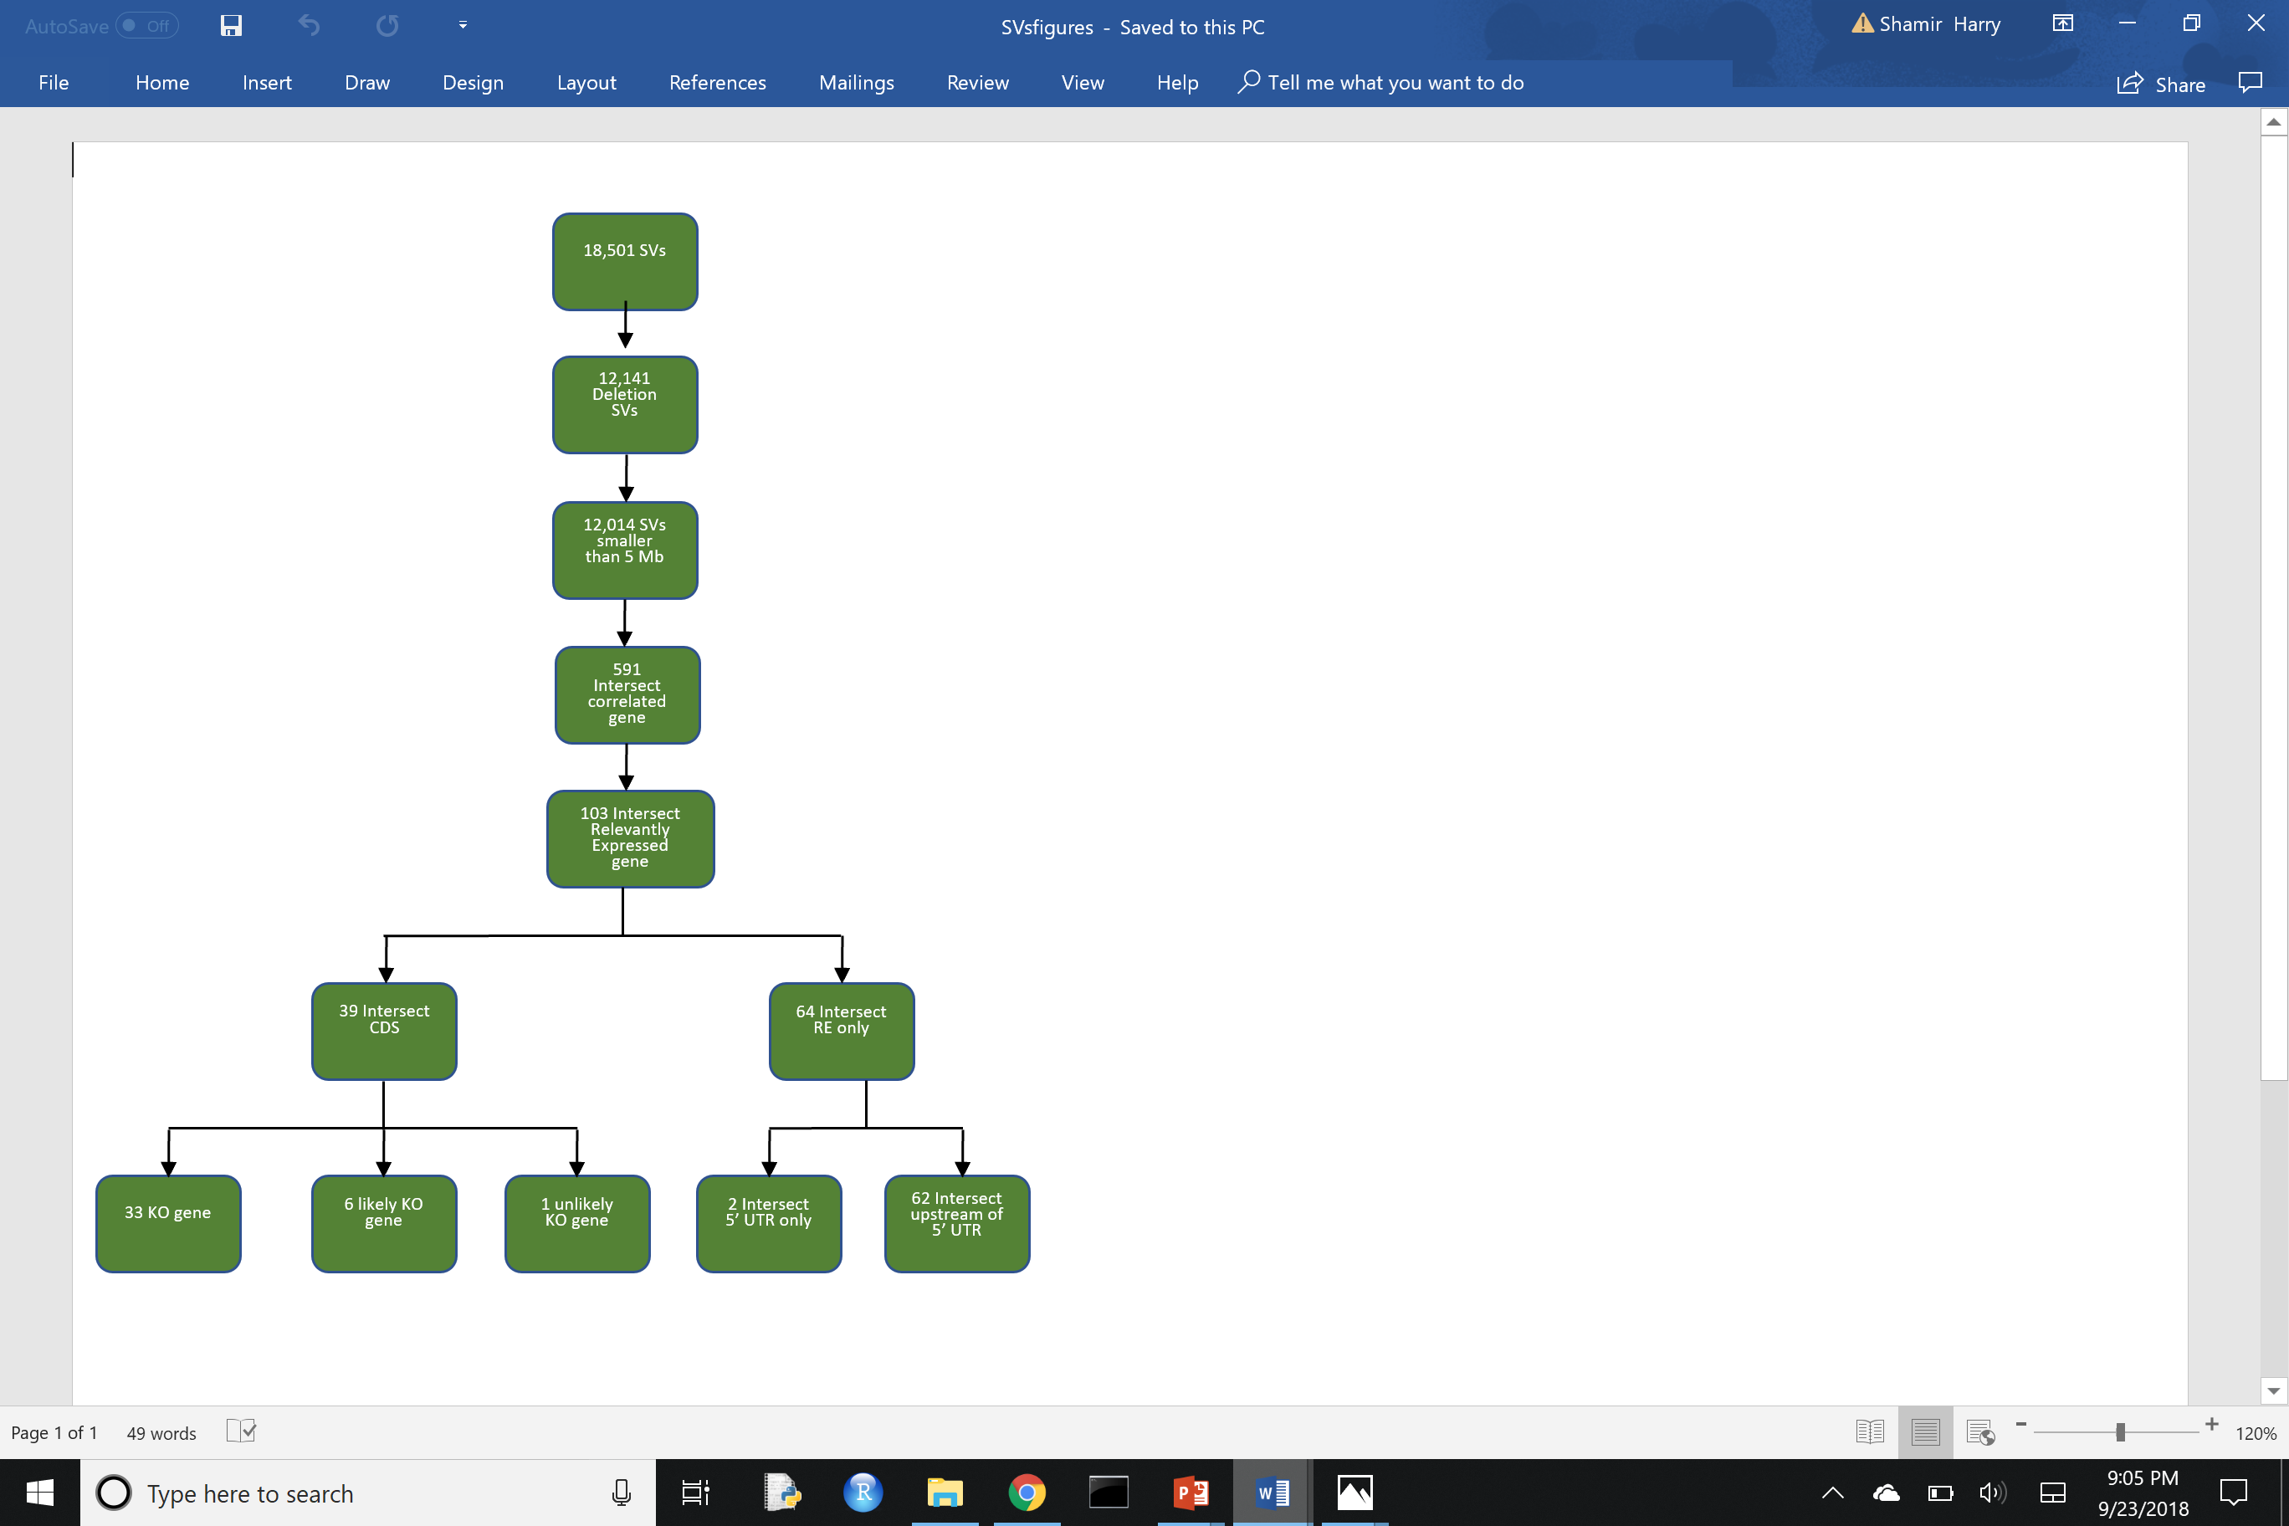
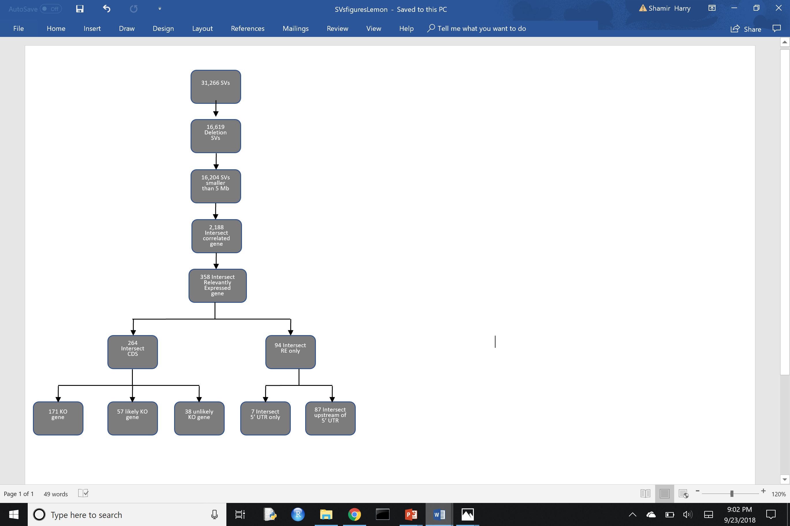
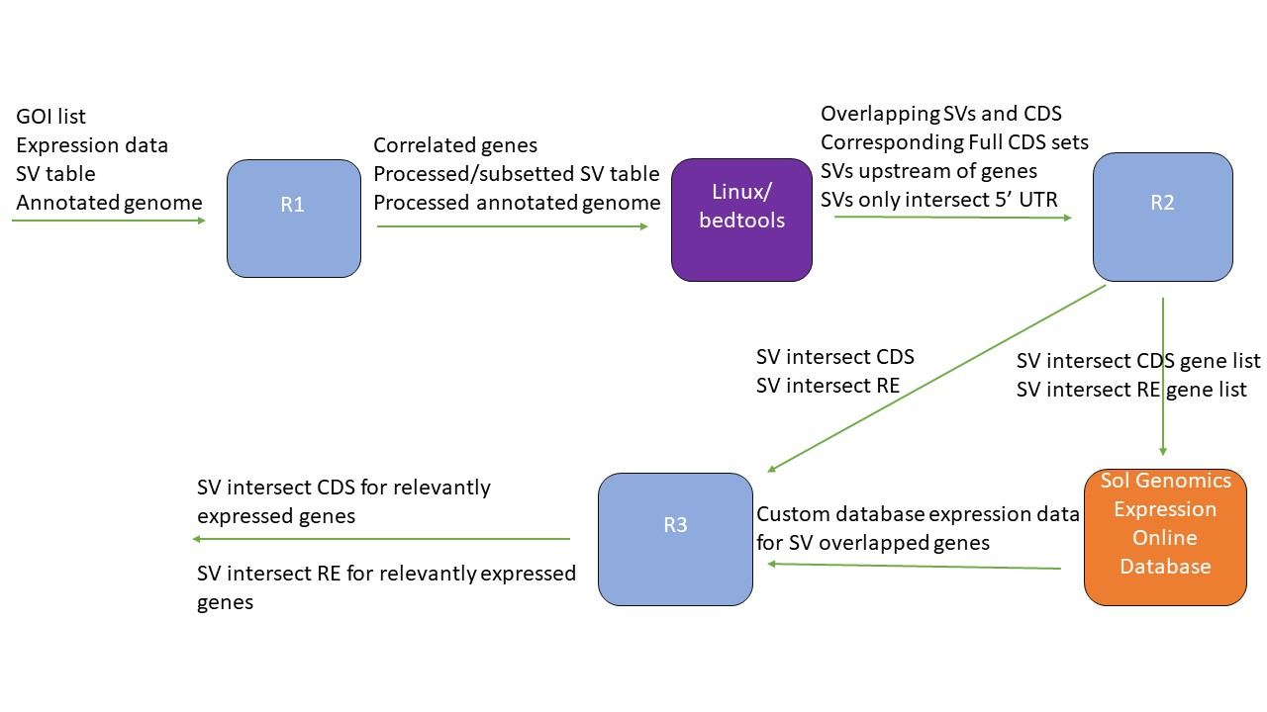
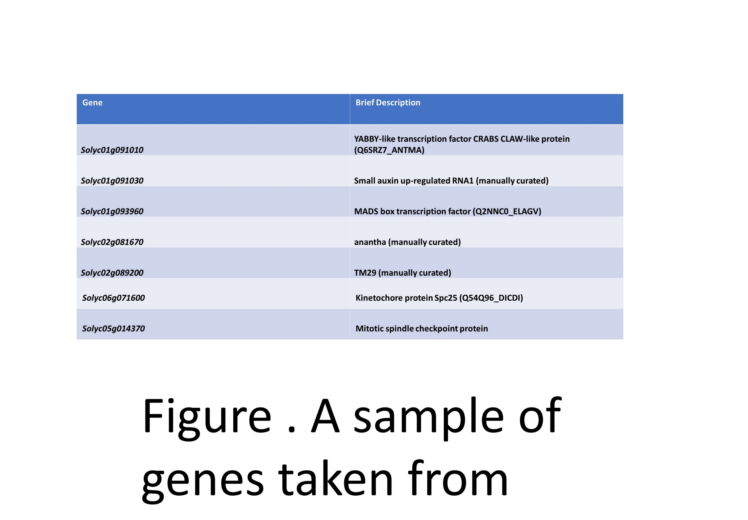
Finding candidate genes relevant to tomato fruit shape and the corresponding genomic structural variation via a bioinformatic approach
Shamir Harry¹, Nathan Taitano¹, Esther van der Knaap¹, Zachary Lippman², Zachary Lemmon², Sofia Visa³
¹Center for Applied Gene Technologies, University of Georgia, Athens, GA
²Cold Spring Harbor Laboratory, Cold Spring Harbor, NY
³The College of Wooster, Wooster, OH
Introduction
Fruit shape and size varies widely across vegetable crops, affecting their processing ability and fresh market value
In tomato, the importance of Tonneau1 Recruiting Motif proteins (TRMs) in affecting fruit shape has recently come to light with regard to their interactions with OVATE Family Proteins with emphasis on the collective effect of these interactions on the elongation of tomato fruit ³
Homologs of the tomato fruit-shape regulator SUN have also been found regulating fruit shape in other fruits ⁴
Genomic structural variation across tomato populations of South and Central American accessions has been influential in fruit shape diversity
Results
Future
Gather more expression data to increase precision of gene expression correlations
Run again with SNP data and newer SV lists being developed by Lippman lab utilizing nanopore sequencing
Ensure SVs are real according to sequence alignment data and manual testing
Research final gene list for those most likely of significance based on literature
Select the most promising genes for transgenic development/confirmation (generate using CRISPR/Cas9 constructs) and observe any effect on fruit shape
Hypothesize evolutionary context of observed results using SVs
A
Final gene/SV numbers for results ran under Visa SV list is more stringent than those for Lippman’s SV list; However, it is yet to be determined if this results in higher quality hits.
Correlated gene numbers are exceptionally high, indicating tighter parameters or more data necessary for correlations
A
B
B
Figure 1. Structural variation underlies sun, fas, and sov1 (A) which in addition to lc and ovate mutations result in a wide range of fruit shapes (B). ¹ ² ³ ⁵
Objectives
Explore other genes that may act to regulate fruit shape via a coexpression analysis of TRM and SUN genes implicated in fruit shape regulation
Assess genomic structural variants for overlap with these potential candidate genes in order to examine existing natural variation
References
¹Rodríguez, G. R., Muños, S., Anderson, C., Sim, S. C., Michel, A., Causse, M., ... & van der Knaap, E. (2011). Distribution of SUN, OVATE, LC and FAS in the tomato germplasm and the relationship to fruit shape diversity. Plant physiology, pp-110.
² van der Knaap, E., Chakrabarti, M., Chu, Y. H., Clevenger, J. P., Illa-Berenguer, E., Huang, Z., ... & Wu, S. (2014). What lies beyond the eye: the molecular mechanisms regulating tomato fruit weight and shape. Frontiers in plant science, 5, 227.
³ Wu, S., Zhang, B., Keyhaninejad, N., Rodriguez, G. R., Kim, H. J., Chakrabarti, M., … & van der Knaap, E. (2018). A novel mechanism underlies morphological diversification in plants. Manuscript submitted for publication.
⁴ Xiao, H., Radovich, C., Welty, N., Hsu, J., Li, D., Meulia, T., & van der Knaap, E. (2009). Integration of tomato reproductive developmental landmarks and expression profiles, and the effect of SUN on fruit shape. BMC Plant Biology, 9(1), 49.
⁵Xu, C., Liberatore, K. L., MacAlister, C. A., Huang, Z., Chu, Y. H., Jiang, K., ... & Van Eck, J. (2015). A cascade of arabinosyltransferases controls shoot meristem size in tomato. Nature Genetics, 47(7), 784.
Methods
Inputs:
Gene of Interest (GOI) List: SUN-like genes with fruit shape significance in other organisms and TRM genes including those that were found not to interact with OVATE but either have conserved domain for their interaction or coexpress with it.
Expression data: RNA-seq data of 4-16 days past initiation flower buds in wild (S. pimpinellifolium) LA1589 accession
Structural Variant (SV) Lists: Two independently generated structural variant lists for mostly semi-domesticated/domesticated (S. cerasiforme/ S. lycopersicum) tomato accessions by the labs of Sofia Visa and Zachary Lippman, respectively.
Annotated Genome: ITAG 2.5 annotated genome for cultivated tomato
Final Parameters Ran
Genes with 0.95 correlation threshold with GOIs
Only SV deletions that are below 5 Mb
RE is set as 5’UTR and 5 kb upstream
Genes defined as relevantly expressed (in a manner likely affecting fruit shape for this case) using conditions that incorporate OVATE and SUN expression patterns and ratios as ideal values for fruit shape regulation associated genes
B
Figure 2. Wild tomato (S. pimpinellifolium) flower buds 7-19 days past floral initiation ⁴
Figure 4. The number of genes (A) and structural variants (B) through each step of pipeline ran under SV lists generated by the Sofia Visa (green) and Zach Lippman (grey) labs, respectively. Each box shows the number of genes/SVs that meets the given condition and all preceding conditions.
Prioritize genes from output that directly relate to cell division/growth and those that have been thoroughly studied (manually curated genes).
Genes that encode for broad or unknown function proteins are largely neglected
Acknowledgments
Thanks to Nathan Taitano and Esther van der Knaap for mentorship, outlining the framework of this project, and conferring insight; Sofia Visa, Zachary Lemmon, Zachary Lippman, for developing SV lists; Yanping Wang for collecting young floral bud RNA-seq expression data.
Table 1. A sample of genes taken from pipeline’s output.
Figure 3. The simplified overall process outlined of the pipeline developed to perform this analysis. In R1, correlated genes from GOI list are found using RNA-seq expression data; additionally, the SV list is subsetted for size and type. In bedtools, SV and correlated gene overlaps are established. In R2, the genes are separated based on if SV overlaps in RE (Regulatory Element) or CDS (Protein Coding Sequence). For those with overlaps in CDS, the full set of CDS for each gene is paired together and the likely mutation induced by each SV is determined. Using the Sol Genomics Expression Viewer online database, publicly available expression data is used to determine if these remaining genes are expressed in preferential fashion via adjustable algorithm.

Slide 23
Other Relevant Research Contributions
Transformation to generate transgenic lines for many constructs related to different projects and following genotyping/CRISPR analysis
Help with technical coding issues in scripts (QTL-seq, data processing in R, etc.)

